Slide 1
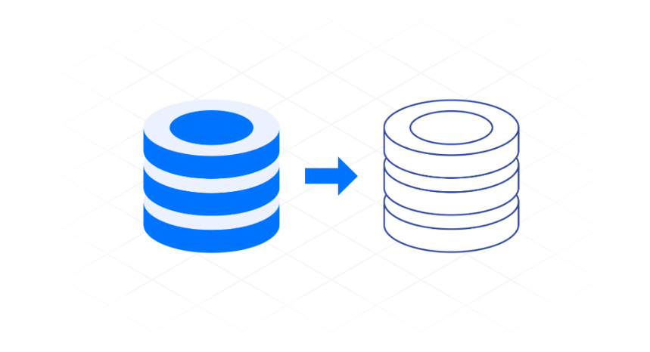
What is Database Replication?

Slide 2
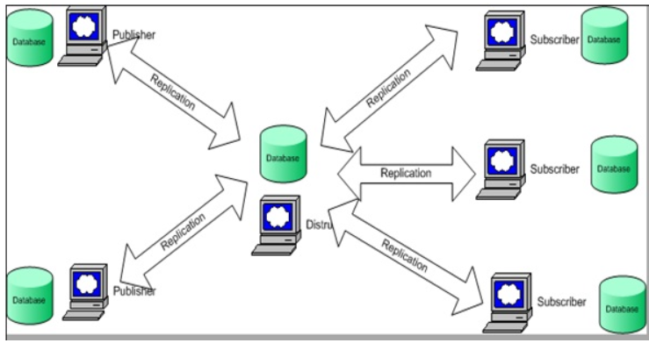
Data Replication Process

Slide 3
Benefits of Database Replication
Improves read performance
Reduced server load
Data more reliable, durable, and data systems more resilient
Disaster recovery
Easier to enable analytics
Lower ;atency

Slide 4
Types of Database Replication
Full-table
Snapshot
Merge (server-to-client)
Key-based incremental
Log-based incremental
Transactional

Slide 5
Database Replication Challenges
High costs
High network bandwidth
Inconsistent data
Loss of data

Slide 6
Thanks

